Slide 1
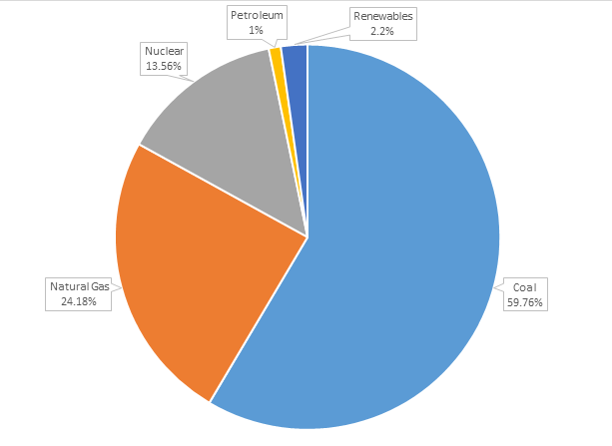
Energy – The Crux of Everything
Affordable, clean, renewable energy is central to, and informs all other sustainable development goals
Ohio current power distribution:

Slide 2
Transition
We need to transition our energy use from fossil fuels to wind, solar, and other clean energy

Slide 3
Wind Farms
2,000,000 people in the Greater Cleveland Area
Requires ~3,500 2MW Turbines
$4 million/turbine
$14 billion for all turbines
~$1 billion a year
The US currently invests around $14 billion annually in wind energy

Slide 4
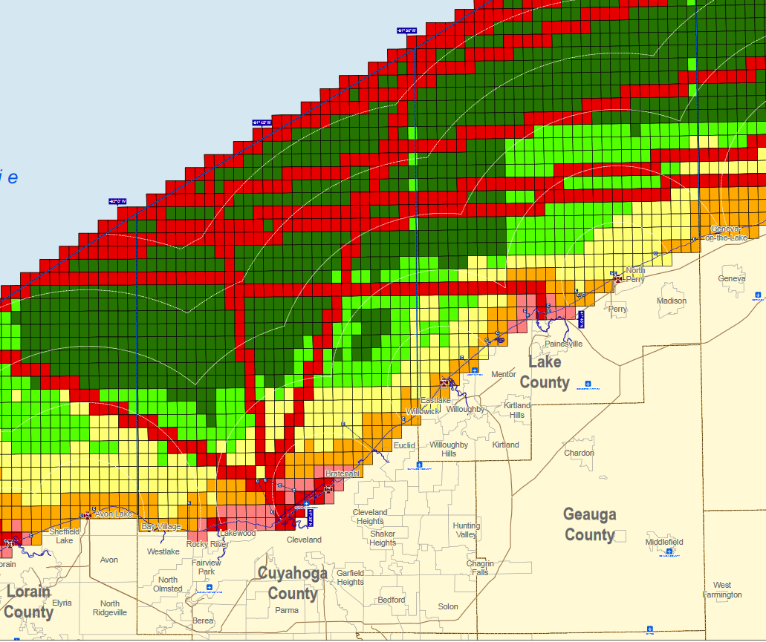
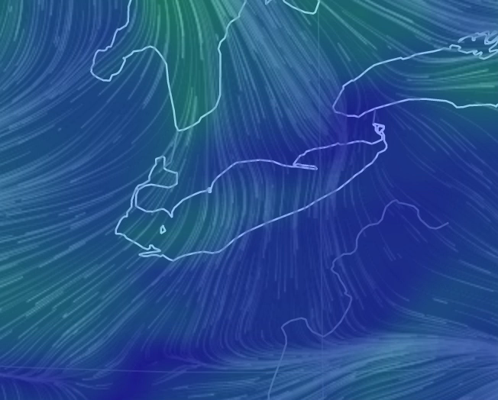
Wind Location
Many turbines can be built off-shore

Slide 5
Supplemental Energy Production
Solar
Inexpensive, and can be placed on may buildings in the city
We don’t have the best weather and sunlight amounts in Cleveland
Nuclear
A huge amount of power available
No one wants one in their backyard
Dangerous

Slide 6
Smart Grid
At the same time as we get new technology, we need to build up a smart grid that can handle the distribution of intermittent power
This includes power storage
Batteries, pumped water, etc.

